Slide 1
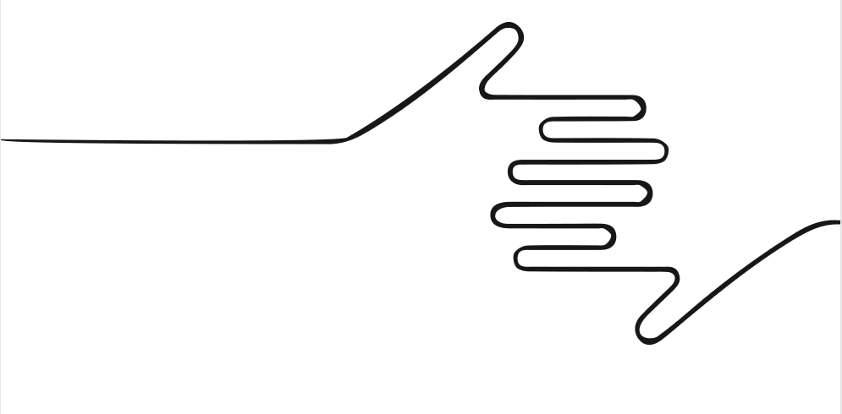

deck of life
discover the world, one card at a time -
- Pedro Alcoforado
- Raul Leal

Slide 2
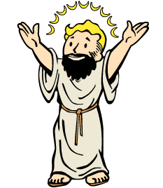
Why is it a problem?
The Lord God said, “It is not good for the man to be alone. I will make a companion for him who corresponds to him.”
Genesis 2:18 (New English Translation)
God said so...

Slide 3



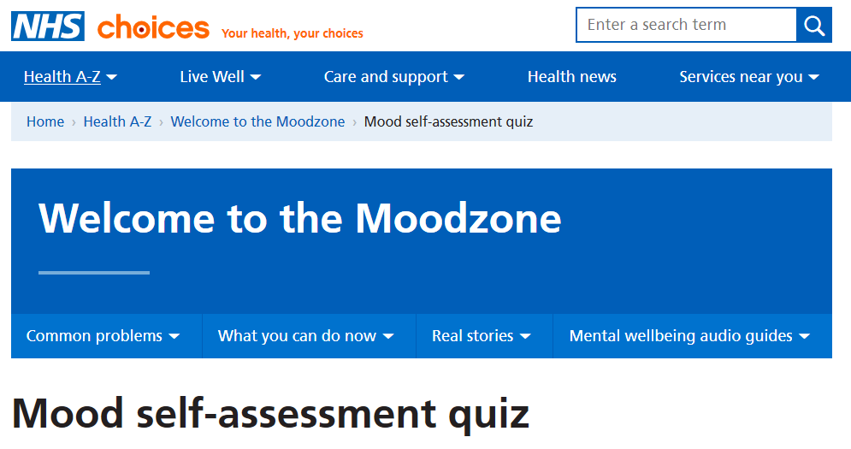


What is being done
Government - Linha Sénior Cascais, NHS MoodZone, Community Centers (ATL)
Nonprofits and communities - Campaign to End Loneliness, Goodgym, Churches

Slide 4
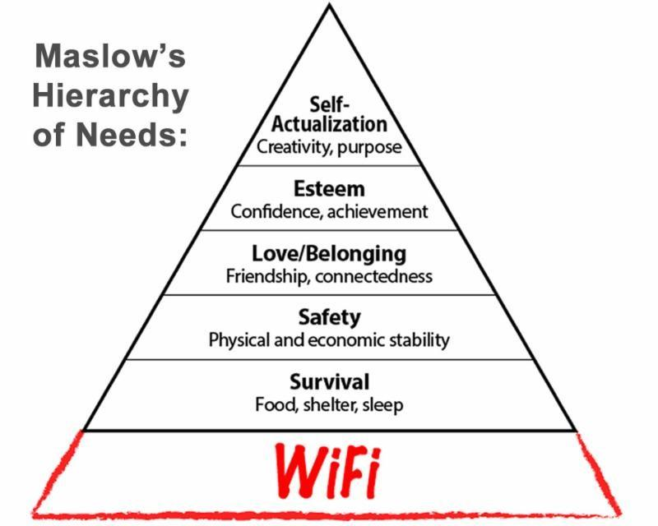
How can we intervene?
Social isolation can lead to a vicious cycle of anti-social behaviour.
It is to find motivation to participate in social activities without positive associations
It can be hard to know where you want to be
Social anxiety and awkwardness make it hard to initiate or sustain communication

Slide 5
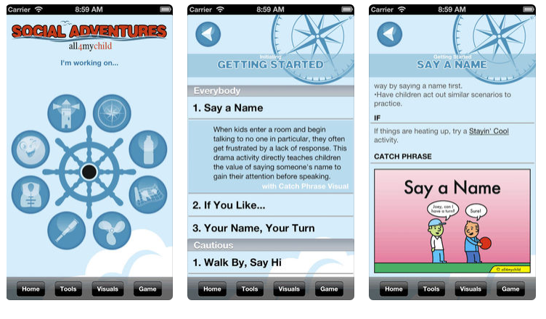
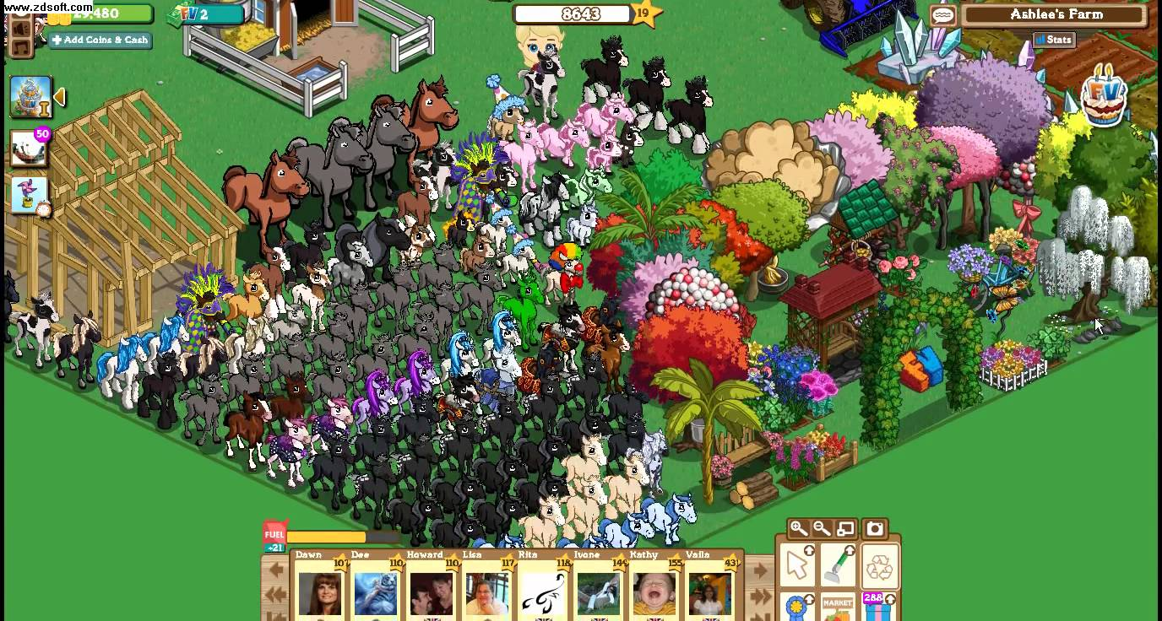
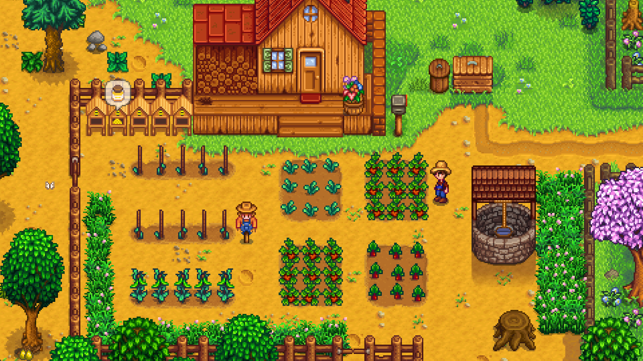

Games

Slide 6
Help the user explore
Identify thoughts that lead to isolation
- Provide an avatar for the user to discover real locations in a safe environment
- Ease the user into social interaction within a positive community
- Reward cooperation and exploration
- Motivate people to improve their lives and the lives of other
Deck of life is a browser based community simulator that aims to help the user explore and engage with the world

Slide 7
The deck of life…?
Activity Cards
- Solo activities
- Go for a walk
- Greet a stranger
- Group activities
- Play a sport
- Organize a flash-mob
Locations
- Discover locations to unlock new activities
- Provide contacts and links to local places
- Special locations during events
- Recurring events like jogging groups or occasional attractions like concerts
- Find people with similar interests

Slide 8
The deck of life…?
Cooperative Game
- Find or invite other players
- Complete cards, challenges
- Create an avatar that reflects you
- Share favourite locations and activities
- Drive real-world interaction
Some activities may be inherently solitary, and the player will be rewarded with opportunities for group activities.
Others may only be performed with a minimum number of people and the player will be rewarded more for activities with larger groups

Slide 9
See you soon!

